Slide 1
SPACESYNC

Slide 2

agenda
Project overview
Core features
Technology stack
Architecture overview
Future enhancements

Slide 3
Project overview
Goal:
To create a web application for workspace management that integrates parking space Workspace and eventspace management.
Objectives:
· Optimize Space Utilization
· Enhance User Experience
· Facilitate Real-Time Availability Management
· Streamline Booking Processes

Slide 4
Core Features
User Features:
Reserve parking slot and workspace .
User can provide feedback and view his previous feedback and replies.
User can track his past reservations.
If the user is a manager then he can reserve a eventspace .
Admin Features:
Admin can view the statistical data of reservations.
Admin can update the user details like role.

Slide 5

Technology Stack
Frontend:
React with TypeScript .
Charkra UI for UI
Backend:
Node.js and Express with Typescript for REST APIs.
Database:
MongoDB for document-based storage.

Slide 6

Architecture Overview
MERN Stack:
React (Frontend), Express + Node.js (Backend), MongoDB (Database).
Microservices:
User Service, Feedback service , parking service , workspace service , eventspace service
Flow:
User and admin authentication using jwt, and role-based access control.

Slide 7
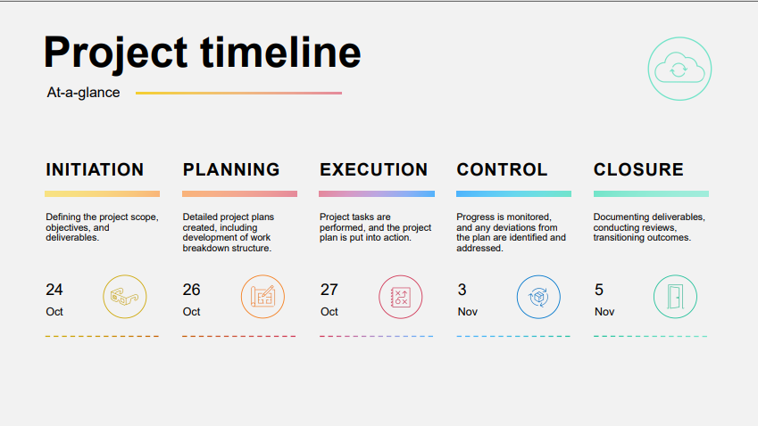

Slide 8
Future Enhancements
Integrating security functionality for parkingspace management.
Enhancing eventspace booking based on time duration.
Enabling the workspace booking for multiple days.
Enable admin to visualize the reservation data of multiple days .

Slide 9

Thank you

